Slide 1
Wireless derailleur
Ian Raúl Huerta Gutiérrez A01228044
Project of Mechatronics Engineering

Slide 2
General objective
To develop a wireless rear derailleur while conducting necessary research.
Try to keep the most original components for the solution.
Manufacture a working prototype.
Produce a solution cheaper than current competitors.
Practice correct documentation of a project.

Slide 3
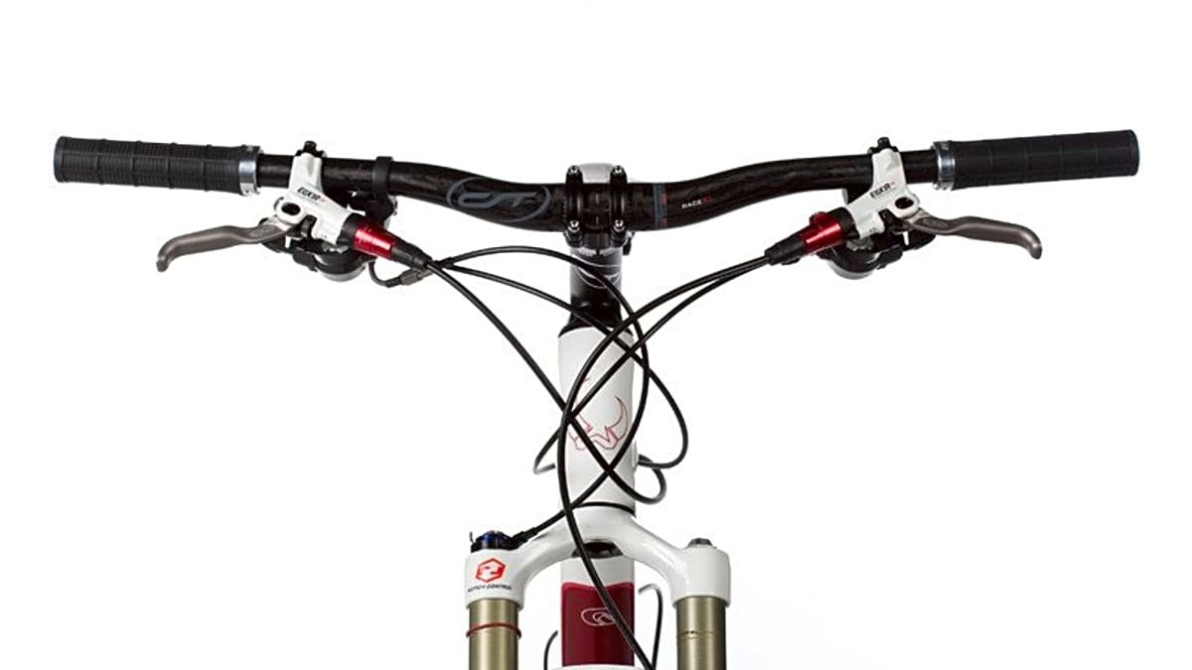
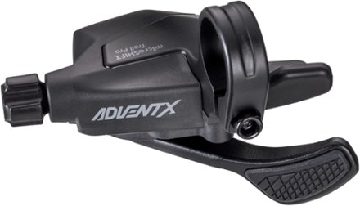
Problem
Clutter cockpit due to the presence of many cables.
Some applications such as enduro racing and dirt jumpers require as less cables as possible to perform tricks.
Adjusting cable tension on the go is time consuming and might require tools.
This project will focus on the right-hand shifter, which is attached to the rear derailleur with a cable and shifts its position depending on the cable’s tension.
MicroShift, 2020
Bike Magazin, 2010

Slide 4
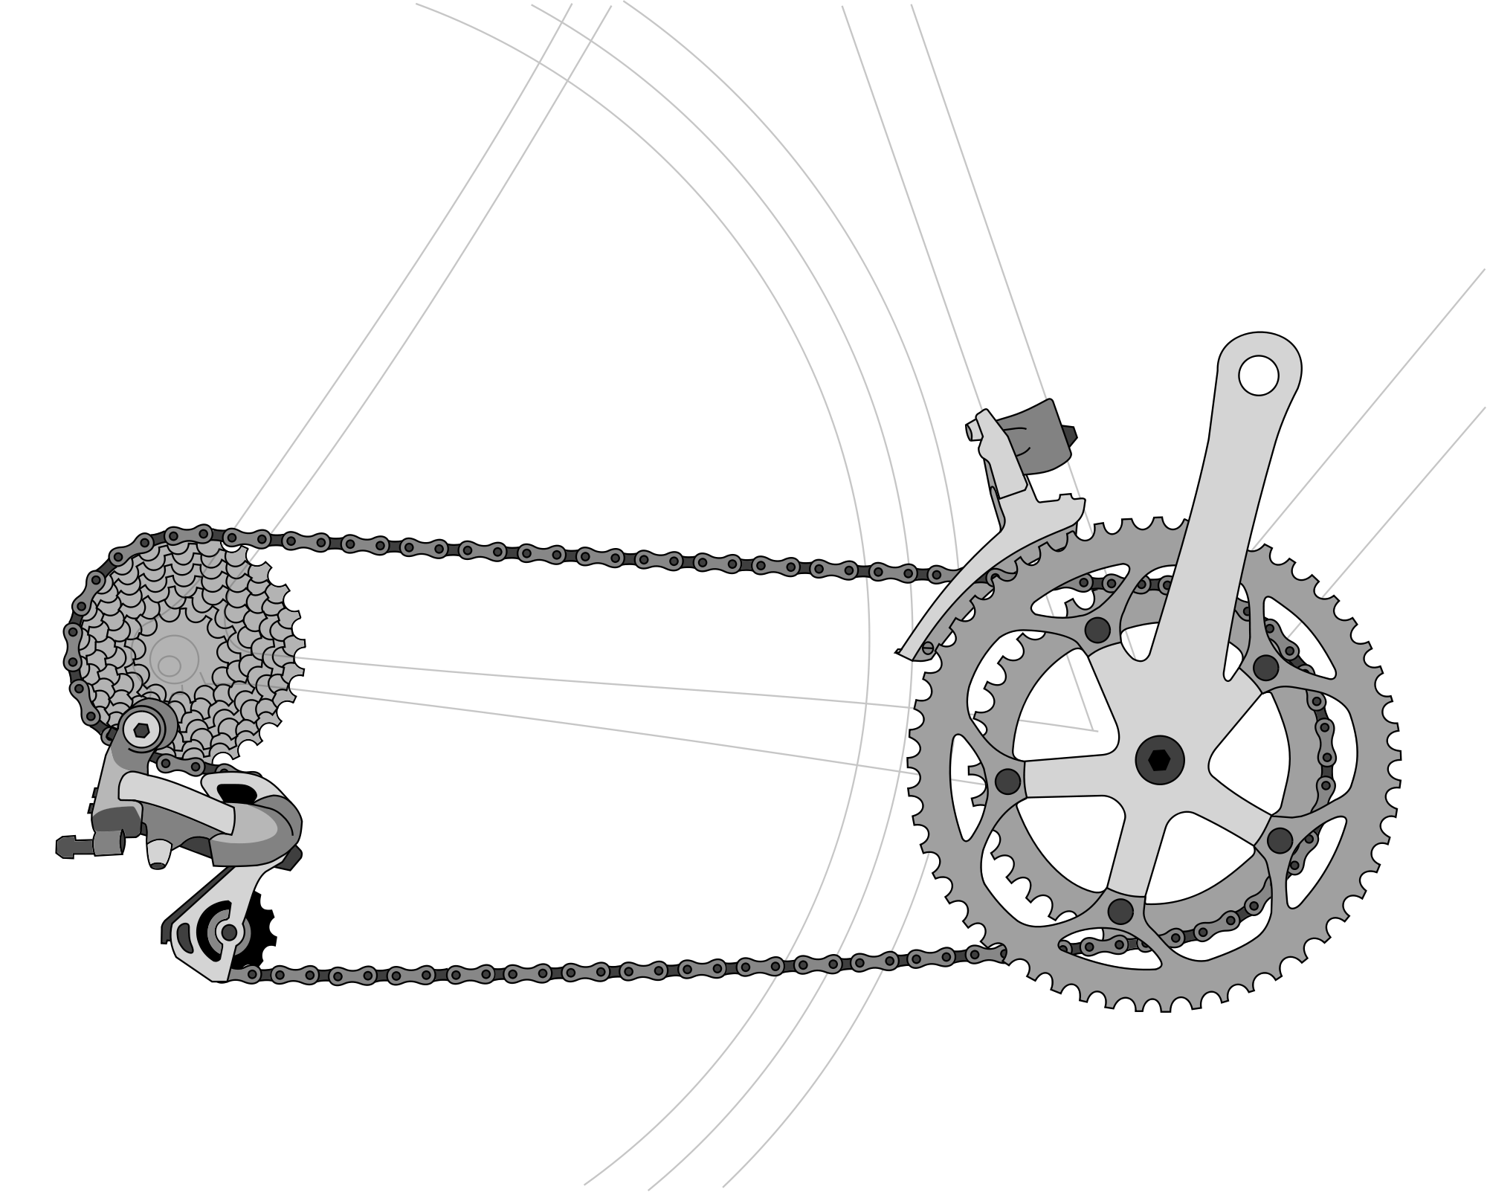
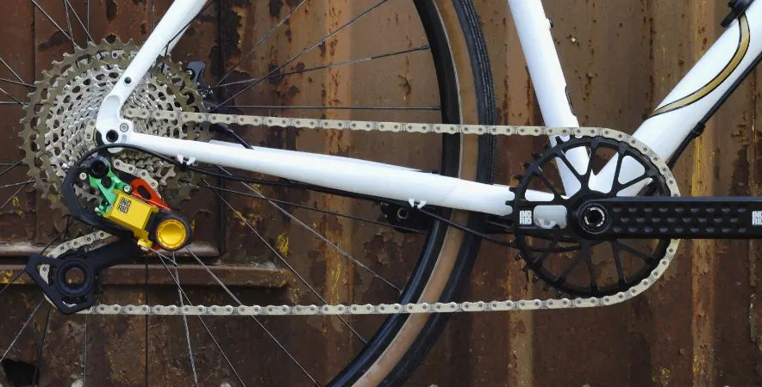
First market solution (optimization)
For modern applications, the front derailleur at the crankset is ditched to make a lighter and easier to maintain mechanism.
Thus, the project will focus on the rear derailleur shifting only, as seen on the image on the right.
Keithonearth, 2009
Ingrid Components, 2022

Slide 5
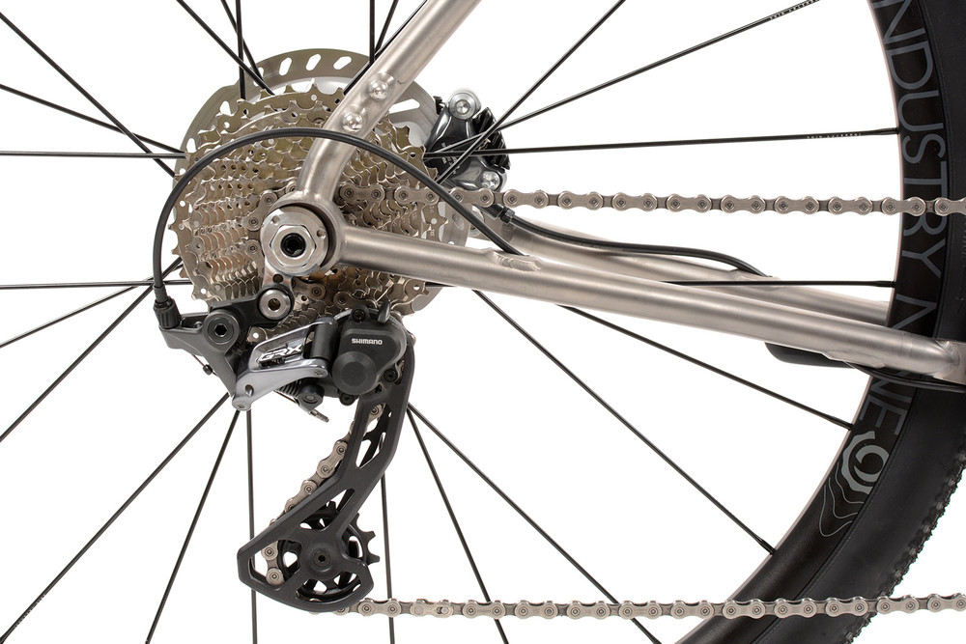
Focus
Rear shifting only.
Using a 9-speed cassette.
Use the original derailleur.
(Use the original shifter.)
Linskey Performance, 2022

Slide 6
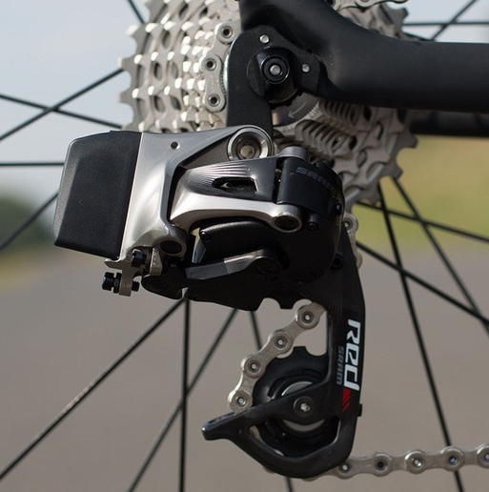
Current market solutions
Although there are already some solutions on the market, these have quite a few disadvantages:
Proprietary systems
Only work if using the same brand as the cassette, chain, and crank.
Prices ranging from $749 - $2690
Depending on the brand, speeds, and complexity.
Low competition
There are only two main brands on the market.
SRAM RED ETAP AXS, 2022

Slide 7






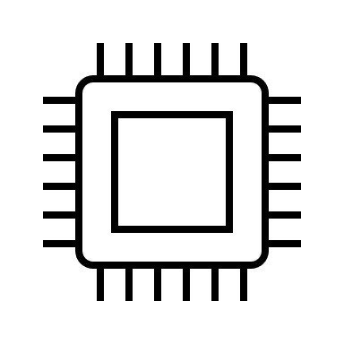
Proposed solution
Shifter controller
Transmitter
Compatible with most systems.
Budget friendly.
Easy to service.
Signal
Original derailleur
Shifting module
Receiver
Cable

Slide 8
Main elements
Shifting module
Electric motor
(Gearing)
Microcontroller
Signal receiver
3D printed case
Mounting bracket
Battery
Power management
Shifter controller
Signal transmitter
3D printed shifter
Mounting bracket
2 shifting buttons
2 tunning buttons
Battery

Slide 9
Scope
Research mechanical and electrical requirements.
Build the shifting module.
Build the shifter controller.
Assemble a working prototype.
Documentation.
Estimate prices for mass production.

Slide 10
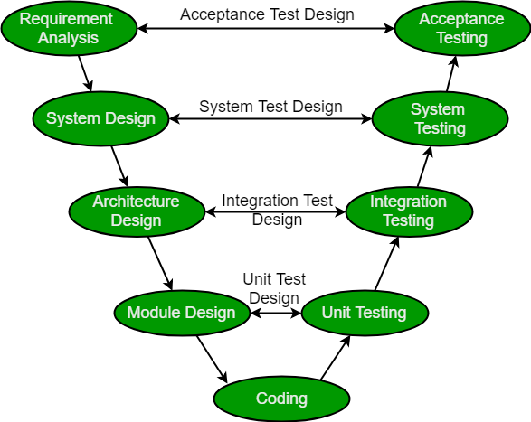
V-Model Development process
GeeksForGeeks, 2022

Slide 11
Engineering Diagram

Slide 12
Questions?

Slide 13
Resources

